Slide 1
Seasonal adjustment processes in statistical production
ROME, October 14, 2024
INFORMAL MEETING #1
ALESSANDRO PIOVANI | alessandro.piovani@istat.it
Istat | Directorate For Methodology and Statistical Process Design

Slide 2
Seasonal Adjustment process
Seasonal adjustment process requires:
storage of data: raw and seasonally adjusted (SA), external regressors
storage of specifications
updating of the data
binding data and specifications
processing

Slide 3
Storage
Workspace (WS):
data and specifications together
in general one workspace per domain (many time series data and spec. together)
WSs created with
GUI: link to external sources (e.g. files, db)
RJDemetra/rjd3: data embedded in workspaces (☺)
Production Data Bases
records = single time series (not domains)
model specifications history: revision checks

Slide 4
Solutions
Store specifications as Workspaces (WS)
NOTE: WS could be zipped and serialized (e.g. Base64 encoding) to be stored as BLOBs in Data Bases
One WS for each time series → merge and split functions
Merge when you want to work on models with the gui to find specifications
Split when you want to store specifications on DB
One WS for each domain (domain = group of time series)
Need to check time series contained in the WS, to assure that they are the same present in the DB
Store specifications as JSON strings
Functions to built WS from JSON specs and viceversa

Slide 5
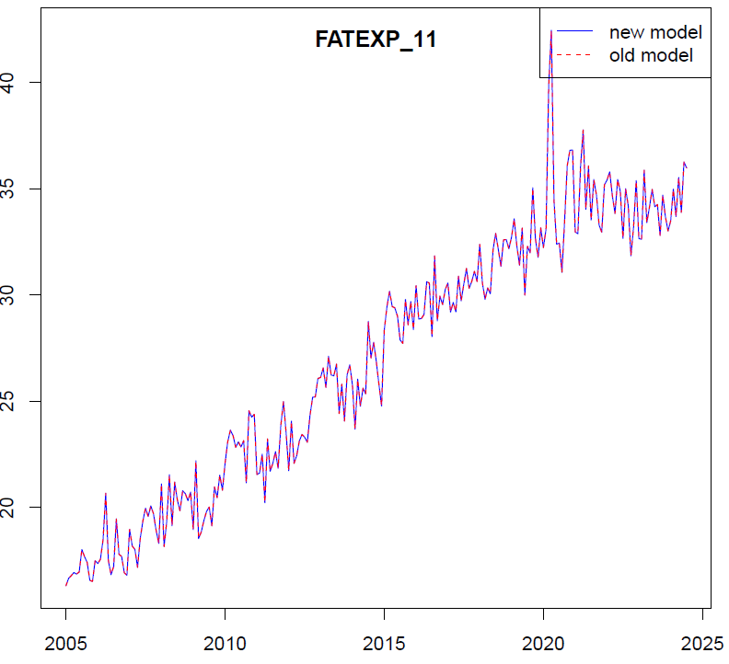
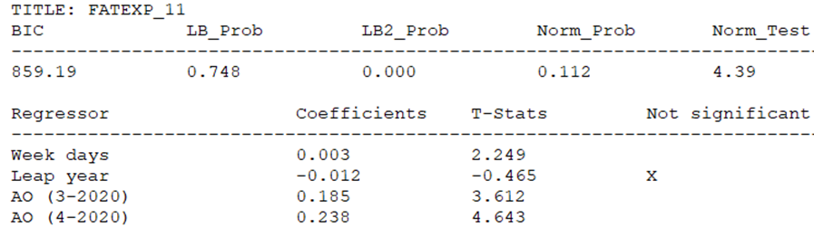
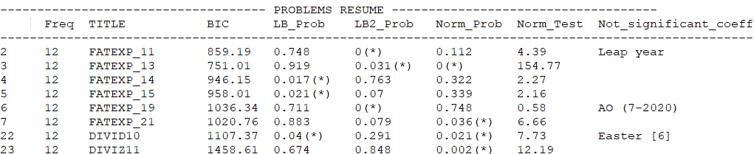
Needs
Functions to update data in workspaces
Global and concise reports on diagnostics
Revisions check plots

Slide 6

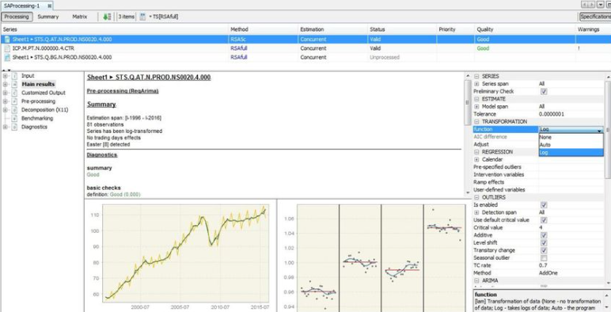
DB models for statistical production: (partial) concurrent revision – SETTING 1: Domain workspaces
Time series name | Metadata | Values | Domain
FATEXP_10 | … | <10, 9.4, 8.9,…> | FAT
C_DEFL | … | <1.2, 3, 2.6,…> | FAT
… | … | … | FAT
VATPIA | … | <3.1, 3, 2.8,…> | TUR
VATAIA | … | <1.6, 2.2, 2.7,…> | TUR
… | … | … | TUR
… | … | … | Other domain
3) decide specs (with GUI, eventually helped by RJDProcessor reports)
Workspace (data+spec) | Domain
 | FAT
 | TUR
 | Other domain
1) Download &…
2) …update_data(data, ws)
*
**
*
**
4) compare_sa_ts(*, **)
5) upload
methodologist's local env.
6) check_external_regressors()
**
check_data(data, ws)
1) Download data and ws (*), 2) update_data, 3) decide specs (with GUI, eventually helped by RJDProcessor reports) and produce a new workspace (**). 4) compare_sa_ts(*, **) to check revisions (iterating back to 3) if you are not satisfied by revisions), 5) upload workspace back to the db, but 6) check_external_regressors and check_data before overwriting the old one. Finally 7) Process the ws
7) Processing
(RJDemetra/rjd3/cruncher)

Slide 7
DB models for statistical production: (partial) concurrent revision – SETTING 2: Single series workspaces
methodologist's local environment
Time series name | Metadata | Values | Domain | Specifications
FATEXP_10 | … | <10, 9.1, 8,…> | FAT
C_DEFL | … | <1.2, 3, 2.6,…> | FAT
… | … | … | FAT
VATPIA | … | <3.1, 3, 2.8,…> | TUR
VATAIA | … | <1.6, 2, 2.7,…> | TUR
… | … | … | TUR
… | … | … | Other domain
1) merge_workspaces() and
download ws (or viceversa) →
*
2) Download data, then call
update_data(data, ws)
3) Decide new specifications (with GUI,
helped by RJDProcessor's reports),
producing a new workspace →
**
4) compare_sa_ts(*, **) to check revisions,
eventually go back to 3
5) get_single_ts_workspaces() and upload
…
**
6) check_data(ws) and
check_external_regressors()
7) Processing
(RJDemetra/rjd3/cruncher)

Slide 8
DB models for statistical production: (partial) concurrent revision – SETTING 3: Separate specs and data (single series)
methodologist's local environment
Time series name | Metadata | Values | Domain | Specifications
FATEXP_10 | … | <10, 9.1, 8,…> | FAT
C_DEFL | … | <1.2, 3, 2.6,…> | FAT
… | … | … | FAT
VATPIA | … | <3.1, 3, 2.8,…> | TUR
VATAIA | … | <1.6, 2, 2.7,…> | TUR
… | … | … | TUR
… | … | … | Other domain
1) Download data and specifications
2) ws_old = JD_JSON_to_workspace
(data, specifications)
{…}
{…}
{…}
{…}
3) Decide new specifications (with GUI,
helped by RJDProcessor's reports) having
ws_old as input, saving all as ws_new
{…}
{…}
4) compare_sa_ts(ws_new, ws_old) to
check revisions, eventually go back to 3
{…}
{…}
5) JD_JSON_from_workspace
(data specifications)
{…}
6) Upload new JSON specifications
{…}
[ {…}, {…}, {…}, {…} ]
7) Processing
(RJDemetra/rjd3/cruncher)

Slide 9
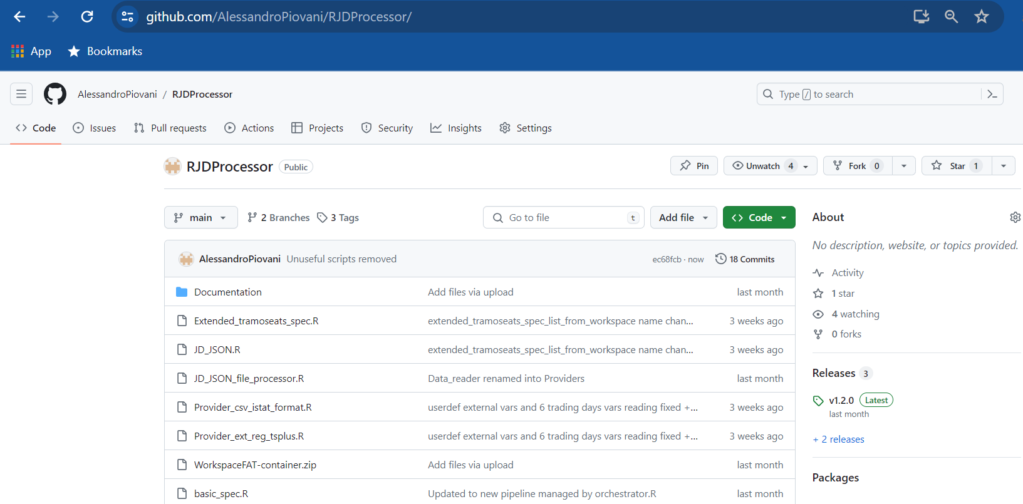
Source code
Source code is available on GitHub:
https://github.com/AlessandroPiovani/RJDProcessor
For information contact me at:
alessandro.piovani@istat.it
alessandro.piovani13@gmail.com

Slide 10
Thanks for your attention!
ALESSANDRO PIOVANI
alessandro.piovani@istat.it

